Slide 1

Business Intelligence Midterm Mini-project Review
Group Members:
1032171203 – Aniket Kumar(PF45)
1032170265– Manish Yadav(PD15)
1032170742 – Rahul Arya(PE20)

Slide 2
Zomato Restaurant Analysis

Slide 3
Problem Statement
Wouldn't it be great if we could search for restaurants serving a specific Cuisine? For example, it would be great to be able to find the best places that serve a Chinese Cuisine.This zomato exploratory data analysis is for the foodies to find best restaurants, value for money restaurants in their locality. It also helps to find their required cuisines in their locality.
We see that the major factor of restaurants is the average cost(for two)of the restaurant. This will let us see the number of restaurants for different average cost .

Slide 4
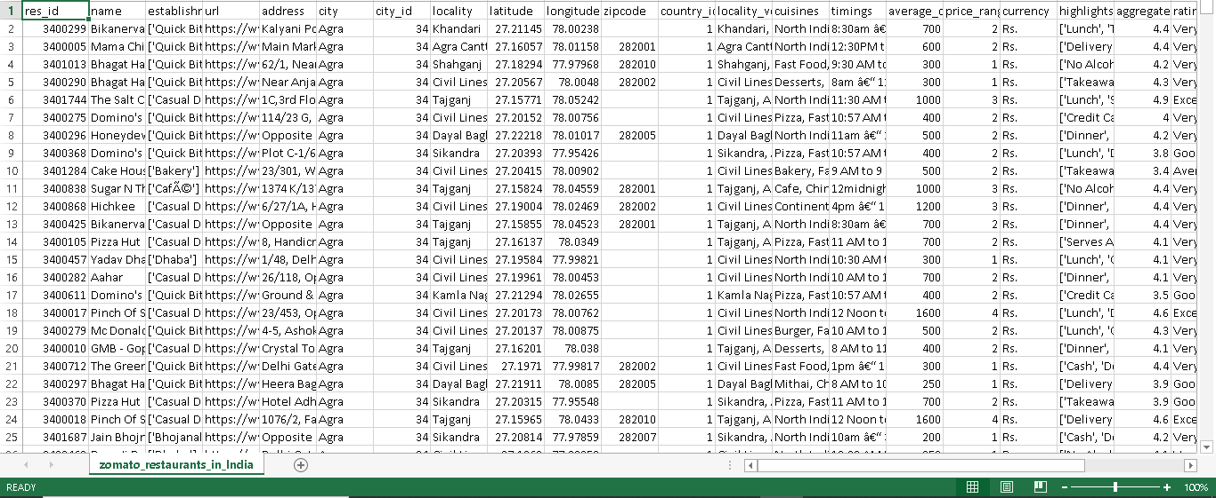
Zomato restaurants analysis

Slide 5
About Dataset:
Name of Dataset: zomato restaurants in india.
Dataset Size:211945 Rows and 27 Columns(109 MB)
Dataset format:Comma separated value file(CSV).
Description:Basically the data has all the zomato restaurants with their ratings, votes and other crucial data attributes to do some research work. This zomato exploratory data analysis is for the foodies to find best restaurants, value for money restaurants in their locality. It also helps to find their required cuisines in their locality. The data was collected using zomato API.

Slide 6
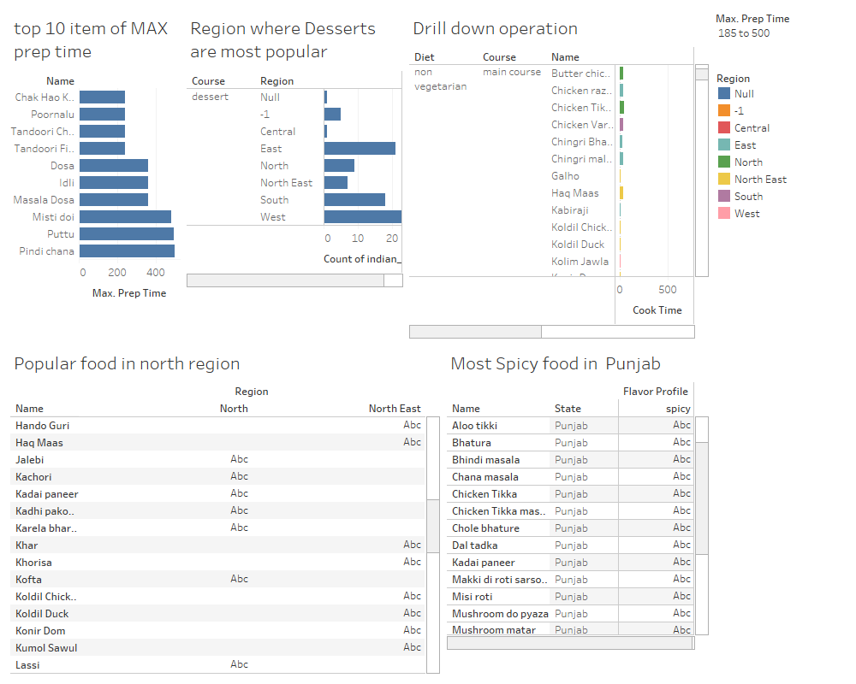
Tableau Analytical Tool
We are using Tableau for visualization and analysis of the dataset. It is a Business intelligence tool for visually analyzing the data. Users can create and distribute an interactive dashboard which depicts trends, density in graph and charts.

Slide 7
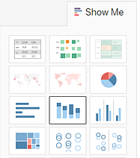
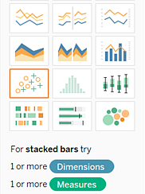
Tableau Analytical Tool
Supports Various types of Charts And Graphs

Slide 8
Thank You

